Slide 1
FUNCTIONAL
DEPENDENCIES
Dr. Jose Annunziato

Slide 2
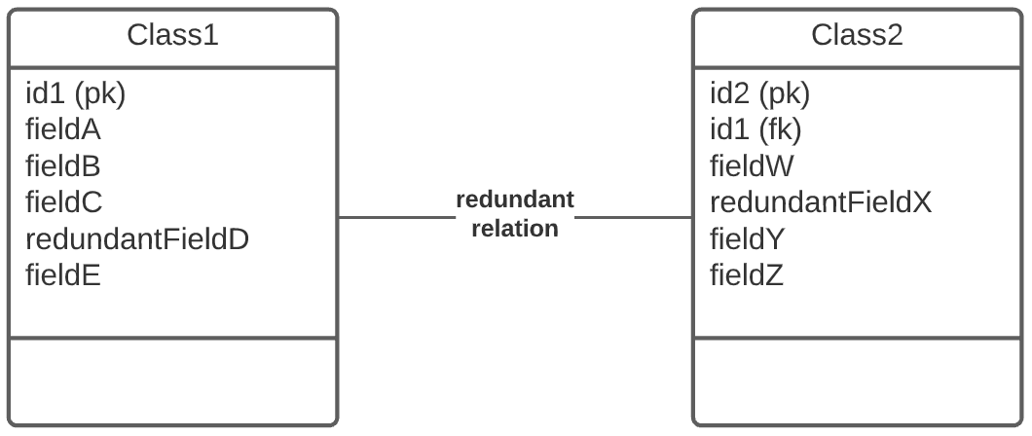
Functional Dependencies
Redundant relations yield redundant fields
Redundant fields can yield inconsistent data
Remove redundant relations from class diagram

Slide 3
Functional Dependencies
Additional redundancies can be identified in relational model.
Redundancies are also due to
Unnecessary attributes
Overlooked constraints

Slide 4
Functional Dependencies
Functional dependencies (FDs) help us identify redundancy in relational schema.
We need to remove functional dependencies

Slide 5
Functional Dependency Example (1/3)
Consider the following table
Notice FullName depends on First and Last
The following functional dependency exists
{First, Last} → FullName = f({First, Last})
determinant → dependent x → y y = f(x)
StudentID | First | Last | FullName
1234 | Alice | Wonderland | Alice Wonderland
2380 | Bob | Marley | Bob Marley
1234 | Charly | Garcia | Charlie Garcia
1201 | Danniel | Craig | Dan Craig

Slide 6
Functional Dependency Example (1/3)
Consider the following table
The problem here is that there's no way to avoid inconsistency between FullName and First + Last
Must identify fields that depend on each other
StudentID | First | Last | FullName
1234 | Alice | Wonderland | Alice Wonderland
2380 | Bob | Marley | Bob Marley
1234 | Charly | Garcia | Charlie Garcia
1201 | Danniel | Craig | Dan Craig

Slide 7
Functional Dependency Example (2/3)
Consider the following table
Notice for same StudentId, we have same Semester
The following functional dependency exists
StudentId → Semester; Semester = f(StudentId)
determinant → dependent x → y y = f(x)
StudentID | Semester | Lecture | TA
1234 | 6 | Numerical Methods | Dante
2380 | 4 | Numerical Methods | Peter
1234 | 6 | Visual Computing | Marco
1201 | 4 | Numerical Methods | Peter
1201 | 4 | Physics II | Simona

Slide 8
Functional Dependency Example (3/3)
Non trivial dependencies also exist
{StudentID, Lecture} → TA
{StudentID, Lecture} → {TA, Semester}
StudentID | Semester | Lecture | TA
1234 | 6 | Web Development | Alice
2380 | 4 | Web Development | Bob
1234 | 6 | Databases | Charlie
1201 | 4 | Web Development | Bob
1201 | 4 | Robotics | Dan

Slide 9
Formally (1/2)
Formally for a set of attributes we say
determinant set → dependent set
X → Y
Where X and Y are sets of attributes
And is read as X functionally determines Y
That is, if we know the values of X then we certainly know the values of Y
That is, Y is some function of X: Y = f(X)
Function establishes relationship R between Y and X

Slide 10
FDs AND
CONSTRAINTS
Dr. Jose Annunziato

Slide 11
University Database FDs
A functional dependency for a relationship R, is a constraint between two sets of attributes X and Y
Consider the University database with added rule
A professor can only teach one course
This rule can be enforced in the SECTION table
SECTION(SId, CId, Prof, YearOffered)
SECTION
Prof
YearOffered
COURSE
Title
* 1

Slide 12
Rule Introduces Func. Dependency
Introduces the constraint (functional dependency)
For same value of Prof, you have same value of CId
The value of Prof functionally determines CId
Functional Dependency (FD): Prof → CId
That is, if you know Prof, you know what they teach
The information is redundant → inconsistency risk
SId | Prof | CId | YearOffered
123 | Einstein | Physics | 1950
122 | Einstein | Physics | 1951
124 | Einstein | Dance | 1952
125 | Einstein | Physics | 1953

Slide 13
Functional Dependency Anatomy
X → Y
Functional Dependencies consist of a Left Hand Side and a Right Hand Side
LHS → RHS
LHS can have multiple attributes

Slide 14
Functional Dependency Example
Consider another rule
All sections in a year must be taught by same Prof
Introduces constraint: given combination CId and YearOffered, the Prof must be the same
{CId, YearOffered } → Prof it's a FD

Slide 15
Functional Dependency Definition
A functional dependency X₁,X₂,…X_{n} → Y asserts that two records with same values X_{i}, must also have same value of Y
FDs can not be determined by data inspection, only from rules

Slide 16
A couple more FD Examples
All sections Prof teaches are from same course:
{Prof, YearOffered } → CourseId
Courses taught at most once a year
{CourseId, YearOffered } → SectionId

Slide 17
Example Functional Dependency
All sections Prof teaches are from same course {Prof, YearOffered} → CourseId
If you know the Prof, and Year, then you know the course they are going to teach
SId | Prof | CId | YearOffered
120 | Einstein | Physics | 1950
121 | Einstein | Physics | 1950
122 | Bohr | Physics | 1950
123 | Einstein | Physics | 1951
124 | Bohr | Physics | 1951
125 | Bohr | Physics | 1951

Slide 18
Example Functional Dependency
Courses taught at most once a year {CourseId, YearOffered} → SectionId
If you know the course and year, then there is only one possible section: {CourseId, YearOffered} → SectionId
SId | Prof | CId | YearOffered
120 | Einstein | Physics | 1950
121 | Einstein | Physics | 1950
122 | Bohr | Physics | 1950
123 | Bohr | Physics | 1951
124 | Bohr | Physics | 1951
125 | Bohr | Physics | 1951

Slide 19
FDs AND
KEYS
Dr. Jose Annunziato

Slide 20
Recall Keys and Superkeys
sid | email | first | last | dob
123 | alice@wonderland.com | Alice | Wonderland | 11/22/2001
234 | alice@rabbithole.com | Alice | Rabbit Hole | 10/21/2002
345 | bob@rice.com | Robert | Rice | 5/6/1997
456 | white@rice.com | White | Rice | 8/7/1990
KEY
SUPER KEY

Slide 21
FDs and Keys
Recall superkeys uniquely identify a record
That is, if you know the values of the fields that make up the superkey, you can unambiguously determine the row
If you know the row, then, all the other fields are determined
In general, if K is a superkey (maybe compound)
K → B is a FD
For all other fields B in the table
So, if we know the FDs, we can determine K

Slide 22
FDs Help Determine Superkeys (1/2)
Consider rule: Courses taught at most once a year
Then FD holds: {CourseId,YearOffered } → SectionId
We know that SectionId is a key
The FD implies that two records with the same {CourseId, YearOffered } must have same SectionId
But there cant be two records with the same SectionId because SectionId is a key
Therefore, {CourseId, YearOffered } MUST be a superkey

Slide 23
Courses taught at most once a year
section_id (pk) | course_id (fk) | year | prof
123 | CS3200 | 2021 | Joe
234 | CS3200 | 2020 | Dan
345 | CS4550 | 2020 | Dan
456 | CS4500 | 2021 | Joe
{course_id, year } → section_id
Because of FD, if section_id is PK, then {course_id, year} must be super key

Slide 24
FDs Help Determine Superkeys (2/2)
In general
If {K1, …, Kn} is a key in table T
And {X1, …, Xm} are some fields in T
Then if FD: {X1, …, Xm} → {K1, …, Kn}
Then {X1, …, Xm} must be a superkey

Slide 25
Full Functional Dependencies
Superkeys can have superfluous fields
Superkeys with no superfluous fields are just keys
FDs with no superfluous fields are called Full FDs
Full functional dependencies imply fields fully determined by keys
If we remove FullName field from below, then all fields only depend on primary key. No fields depend on other fields
StudentID | First | Last | FullName
1234 | Alice | Wonderland | Alice Wonderland
2380 | Bob | Marley | Bob Marley

Slide 26
Full Functional Dependencies
Superkeys can have superfluous fields
Superkeys with no superfluous fields are keys
FDs with no superfluous fields are called Full FDs
Full functional dependencies imply fields fields fully determined by keys
If we add superfluous fields in FDs, FD still holds
Consider rule: Prof always teaches same course
Then FD is: Prof → Course
If we add any other field, such as YearOffered: {Prof, YearOffered} → Course
The original FD still holds
New FD means: Prof teaches one course per year
Less restrictive

Slide 27
Full Functional Dependencies
Full functional dependencies have no superfluous fields in its LHS {X1, …, Xm} → {K1, …, Kn}
If these are non superfluous fields, then the LHS is a key
We say Full FDs are key-based if LHS is a key
A Full FD implies, or specifies, a key

Slide 28
Non-Key-Based Functional Dependency
Non-key-based FDs don’t have a key on LHS
Consider rule: Prof teaches same course every year
Yields FD: Prof → Course
Where Prof is not a key

Slide 29
Non-Key-Based Functional Dependency
Since Prof is not a key, then there can be several records with the same pair values {Prof, Course}
Clearly these two fields would be a redundancy!
In general: Tables with Non-key-based FDs have redundancies

Slide 30
Why Non-Key-Based FDs?
Non-key-based FDs occur because of
Inappropriate attribute choice
Omitted relationships
Undetected redundant relationships

Slide 31
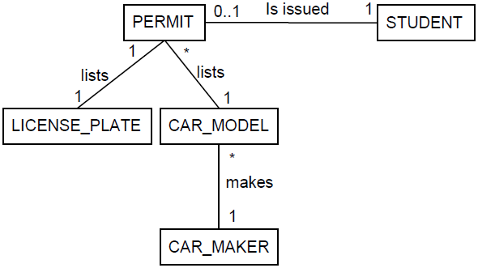
Choosing Inappropriate Attributes
Consider requirement: Parking permits must list license plate, car model, and manufacturer
Class diagram might be

Slide 32
Example
CAR_MAKER has many-one with CAR_MODEL
Every model has specific maker
PERMIT CAR_MODEL CAR_MAKER
123
234
345
456
567
678
 | Corolla
 | 4Runner
 | Rav4
 | Cherokee
 | Liberty
 | Wrangler
 | Hunday
 | Toyota
 | Audi
 | BMW
 | Jeep
 | Ford

Slide 33
Identifying Non-Key-Based FDs
Since we don’t really need to model details of car makers, we might decide to roll CAR_MODEL and CAR_MAKER into PERMIT as attributes
PERMIT(PermitId, LicensePlate, CarModel,
CarMaker, StudentId)
But notice that given a value for CarModel, there can only be a respective CarMaker
Therefore, FD: CarModel → CarMaker

Slide 34
Non-Key-Based FDs → Redundancy
The FD: CarModel → CarMaker
Warns redundancy risk → inconsistency risk
If we know the car model, then we know the car maker
If we know it's a corolla, then we know it's a toyota

Slide 35
Non-Key-Based FDs → Redundancy
Since not keys, there'll be multiple records with the same pair values {CarModel, CarMaker}
i.e., lots of {corolla, toyota} → redundancy
Since they are not keys, nothing stops someone introducing bad data
e.g., {corolla, gm}, {corolla, ford} → inconsistency

Slide 36
Fixing Non-Key-Based FDs
Ignore it as irrelevant or fix it
Fix it by using referential integrity to enforce pk/fk constraint
CarModel and CarMaker can't be attributes, needs to be class CAR_MODEL with attributes model and maker:
PERMIT(PermitId, LicPlate, CarModelId, StudentId)
CAR_MODEL(CarModelId, ModelName, Maker)

Slide 37
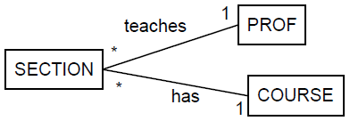
Omitted Relationships
Missing many-one relations may produce non-key-based functional dependency
Consider rule: Prof teaches exactly one course
At a glance we may not consider making a relation between class PROF and COURSE:
SECTION(SectId, Prof, CourseId)
COURSE(CourseId, Title)

Slide 38
Identifying Omitted Relationships
Revising requirement Prof teaches exactly one course we notice a functional dependency (FD)
The requirement specifies FD: Prof → CourseId
Since Prof is not a key, then it's non-key-based FD
Means redundancy → inconsistency

Slide 39
Fixing Omitted Relationships
Revise class diagram & regenerate relational model
Need relation between PROF and COURSE where a PROF record refers to a COURSE record
Then relationship between SECTION and COURSE is redundant and removed
Revised schema:
SECTION(SectId, ProfId)
PROF(ProfId, PName, CourseId)
COURSE(CourseId, Title)
*
1

